Slide 1
Assignment-1
Anish Khanal
Ujjwal Khatri
Prashant Bhattarai
Syed roman

Slide 2
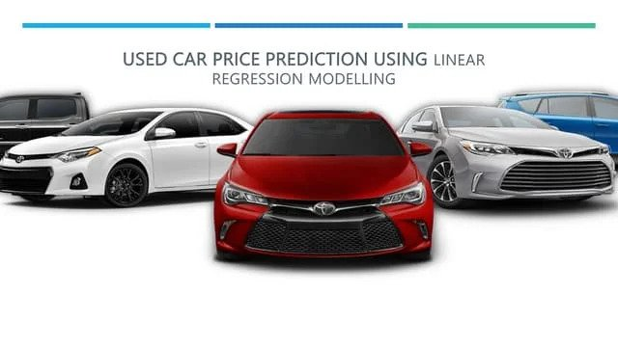

Slide 3

AGENDA
INTRODUCTION
OBJECTIVE
TECHNOLOGY USED
SYSTEM DESIGN
METHODOLOGY
TERMINOLOGIES USED IN DATASET
CONCLUSION

Slide 4
INTRODUCTION
Cars24 is a leading online platform for buying and selling used cars.
With a vast network of sellers and a wide range of pre-owned vehicles, Cars24 offers a convenient and reliable way for individuals to find their ideal used car or sell their existing vehicle.
It offers a comprehensive database of used cars, allowing users to browse through various makes, models, and price ranges to find the perfect match for their needs and budget.

Slide 5
OBJECTIVE
Develop a machine learning model to accurately predict the prices of used cars based on their features, providing valuable insights to buyers and sellers in the used car market.
Identify the key factors influencing the price of used cars by analyzing the relationships between features such as year, kilometers driven, fuel type, transmission, engine specifications, and power.
Evaluate and compare the performance of different regression algorithms, such as linear regression, lasso regression, and ridge regression, to determine the most suitable model for predicting car prices in this specific dataset.
Providing graphical comparisons to provide a better view.

Slide 6
TECHNOLOGY USED
PANDAS
SCIKIT-LEARN
MATPLOTLIB
SEABORN
NUMPY
LINEAR REGRESSION
SKLEARN
PLOTLY

Slide 7
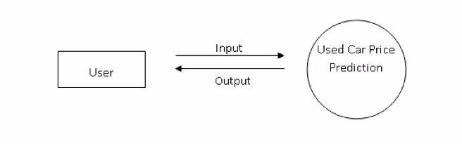
SYSTEM DESIGN
A data flow diagram shows the way information flows through a process or system. It includes data inputs and outputs; data stores and the various sub processes the data moves.

Slide 8
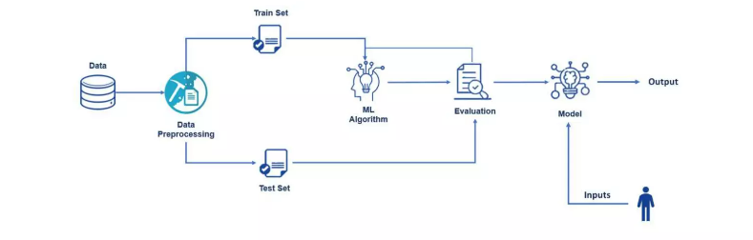
SYSTEM DESIGN
True data is noisy, therefore, it is necessary to clean data to obtain actual information.
Different process are carried out such as manual encoding and one hot encoding.
Feature extraction is performed to extract necessary features.
Linear regression modelling is used to train the dataset.

Slide 9

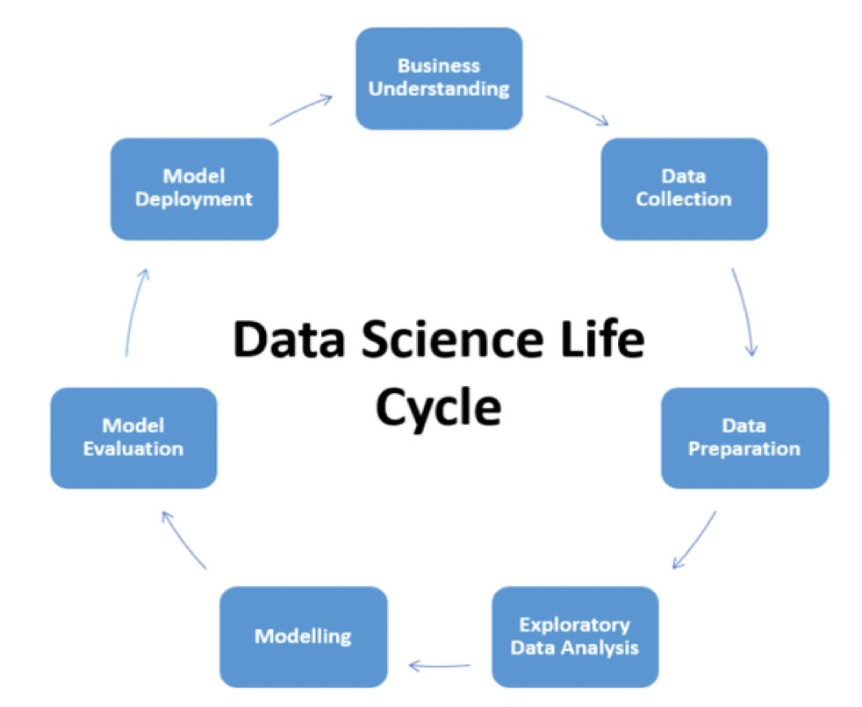
METHODOLOGY

Slide 10
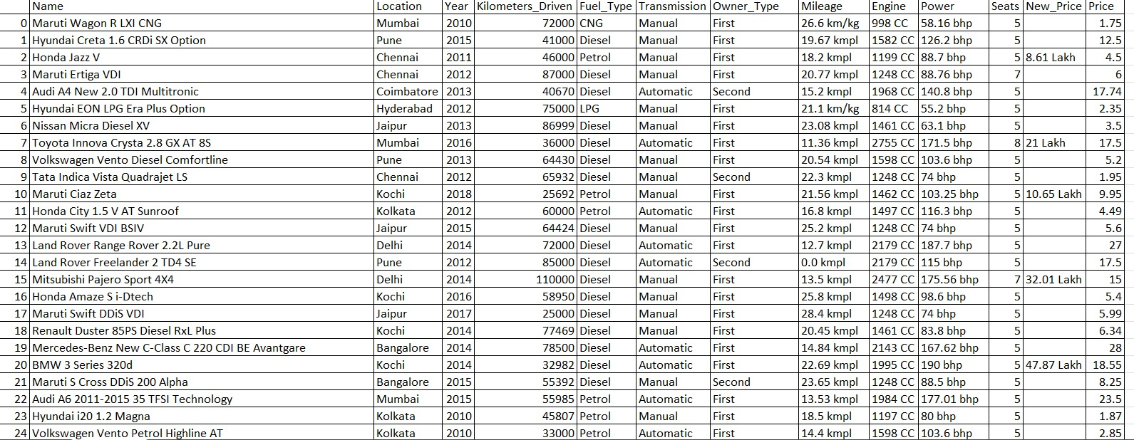
DATASET

Slide 11
Dataset Understanding
The given dataset has a collection of information about different cars.
Each row represents a specific car model and provides various details about it.
There are 6019 rows and 14 cols in the dataset. Here is a breakdown of the columns in the dataset:

Slide 12
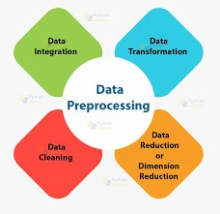
Data preprocessing
Data preprocessing is a critical step in data analysis that involves preparing and cleaning the raw data before it can be used for further analysis. It plays a crucial role in ensuring the accuracy, reliability, and effectiveness of the subsequent analysis

Slide 13
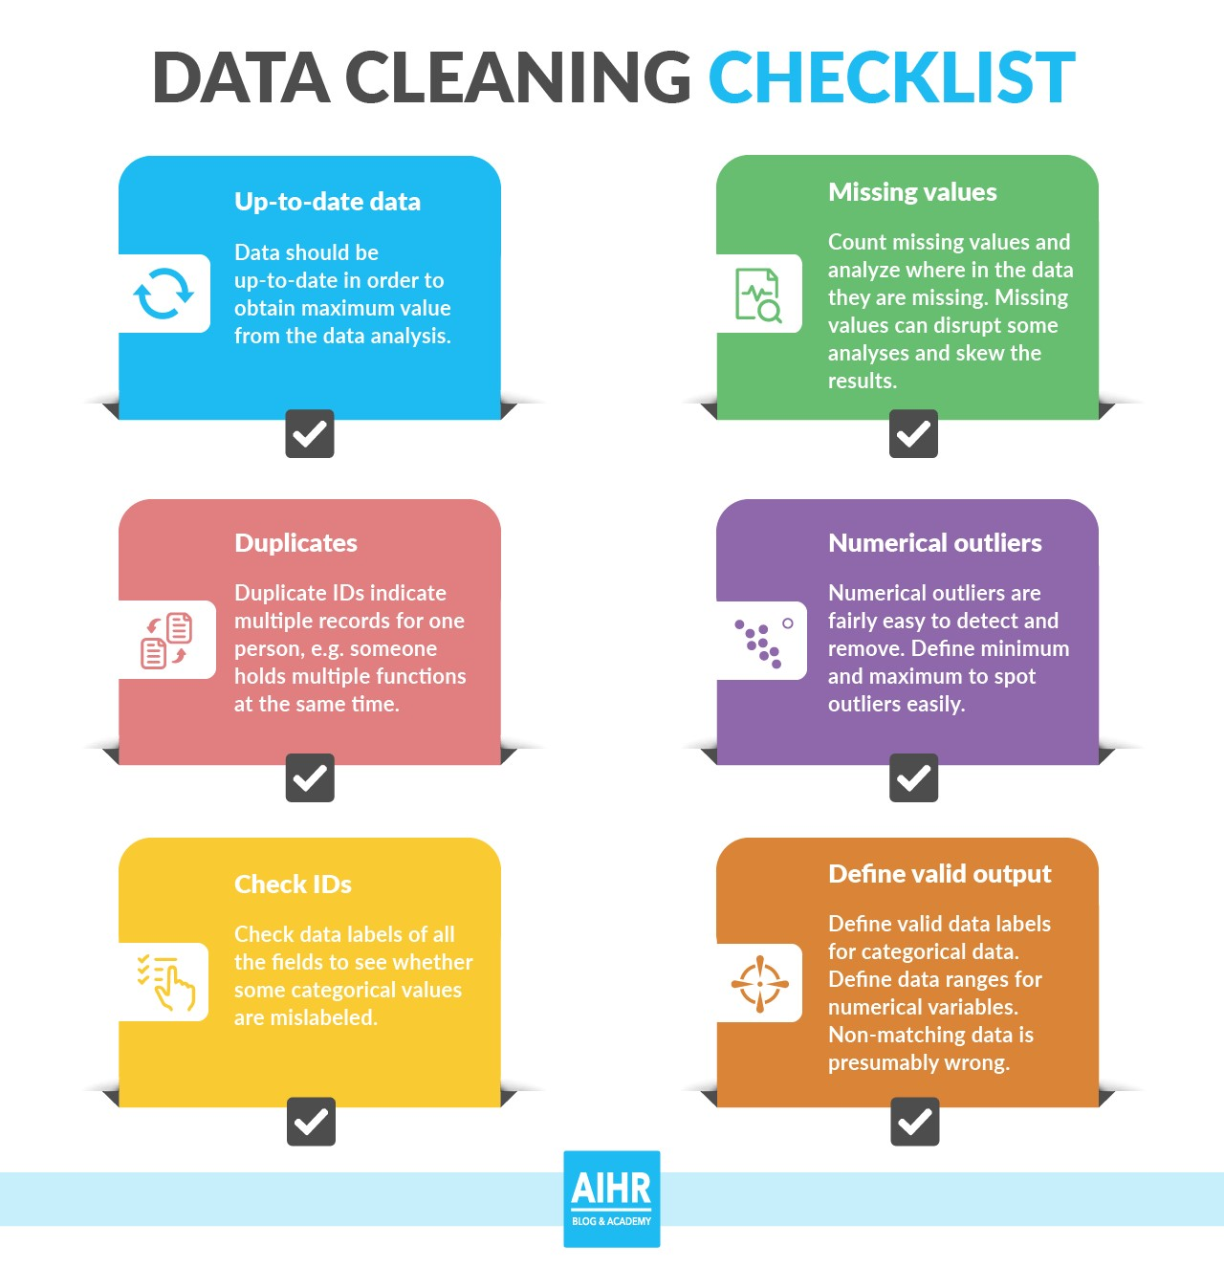
Data Cleaning

Slide 14
Data Wrangling
1. Encoding - Transforming the categorical values of the relevant features into numerical ones
2.Scaling – Decreasing the magnitude value so that model can fit within a specific scale
3.Normalizing- Converting skewed data to normal distribution
4.Data discretization- way of turning large numbers of data values into smaller ones making data interpretation much easier

Slide 15
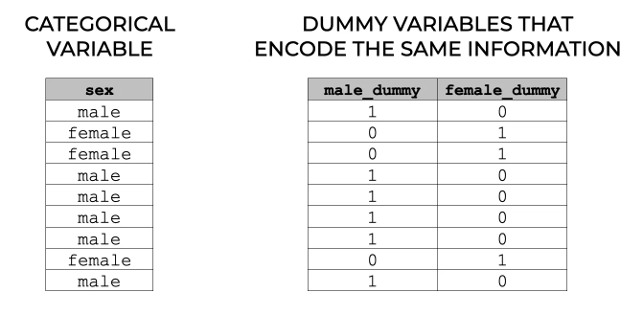
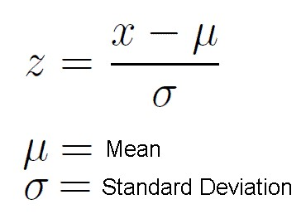
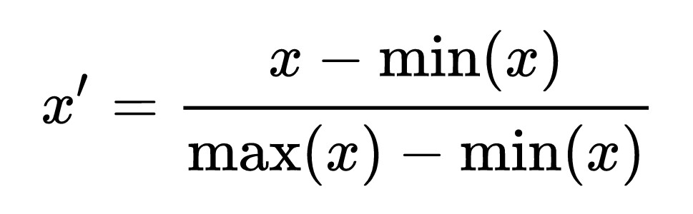
Encoding
1.Standard scaler
2.MinMaxScaler

Slide 16
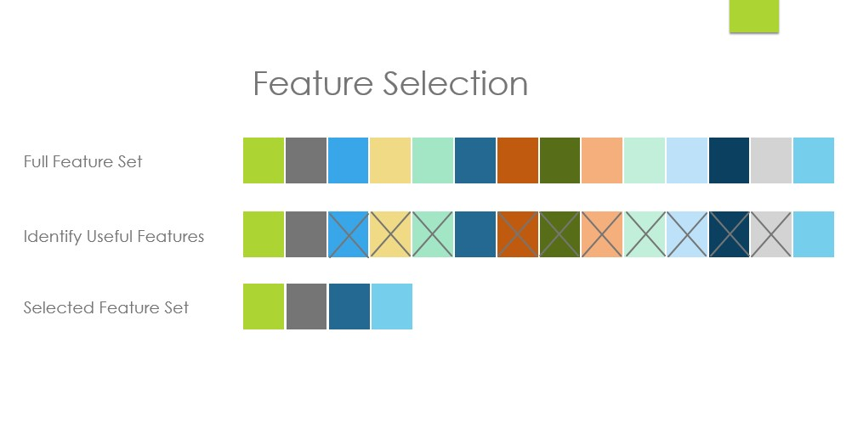
Feature Selection

Slide 17
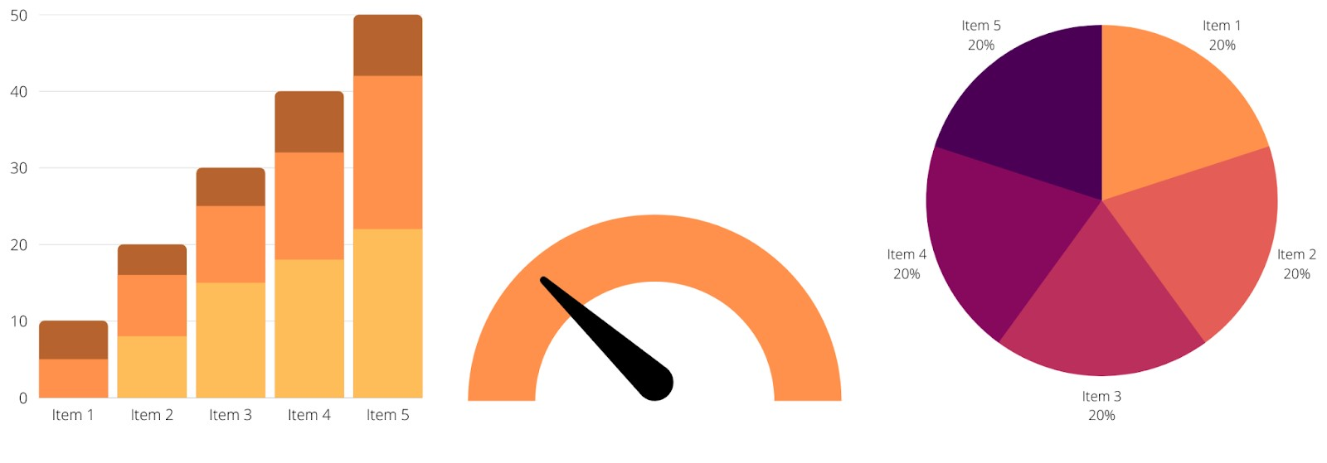
Data Visualization
Data visualization is the representation of data in graphical or visual form to facilitate understanding, exploration, and communication of patterns, trends, and insights within the data.

Slide 18
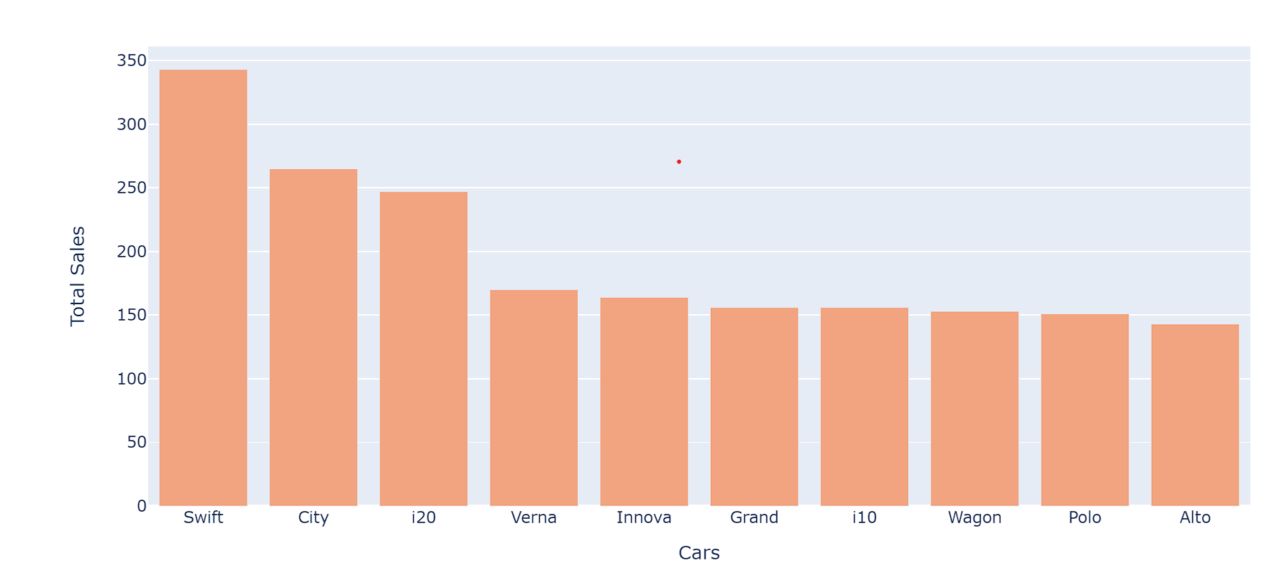
Univariate Analysis
The graph allows you to see the ranking of the top 10 car models based on their sales counts.
The models are typically listed from highest to lowest sales count.

Slide 19
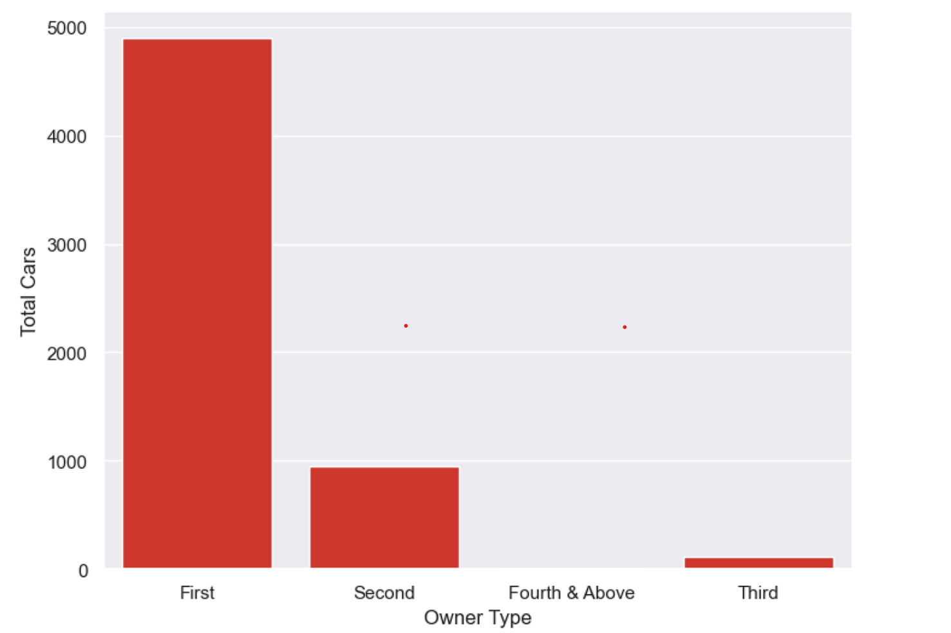
Univariate Analysis
The graph displays the distribution of cars based on their owner types.

Slide 20
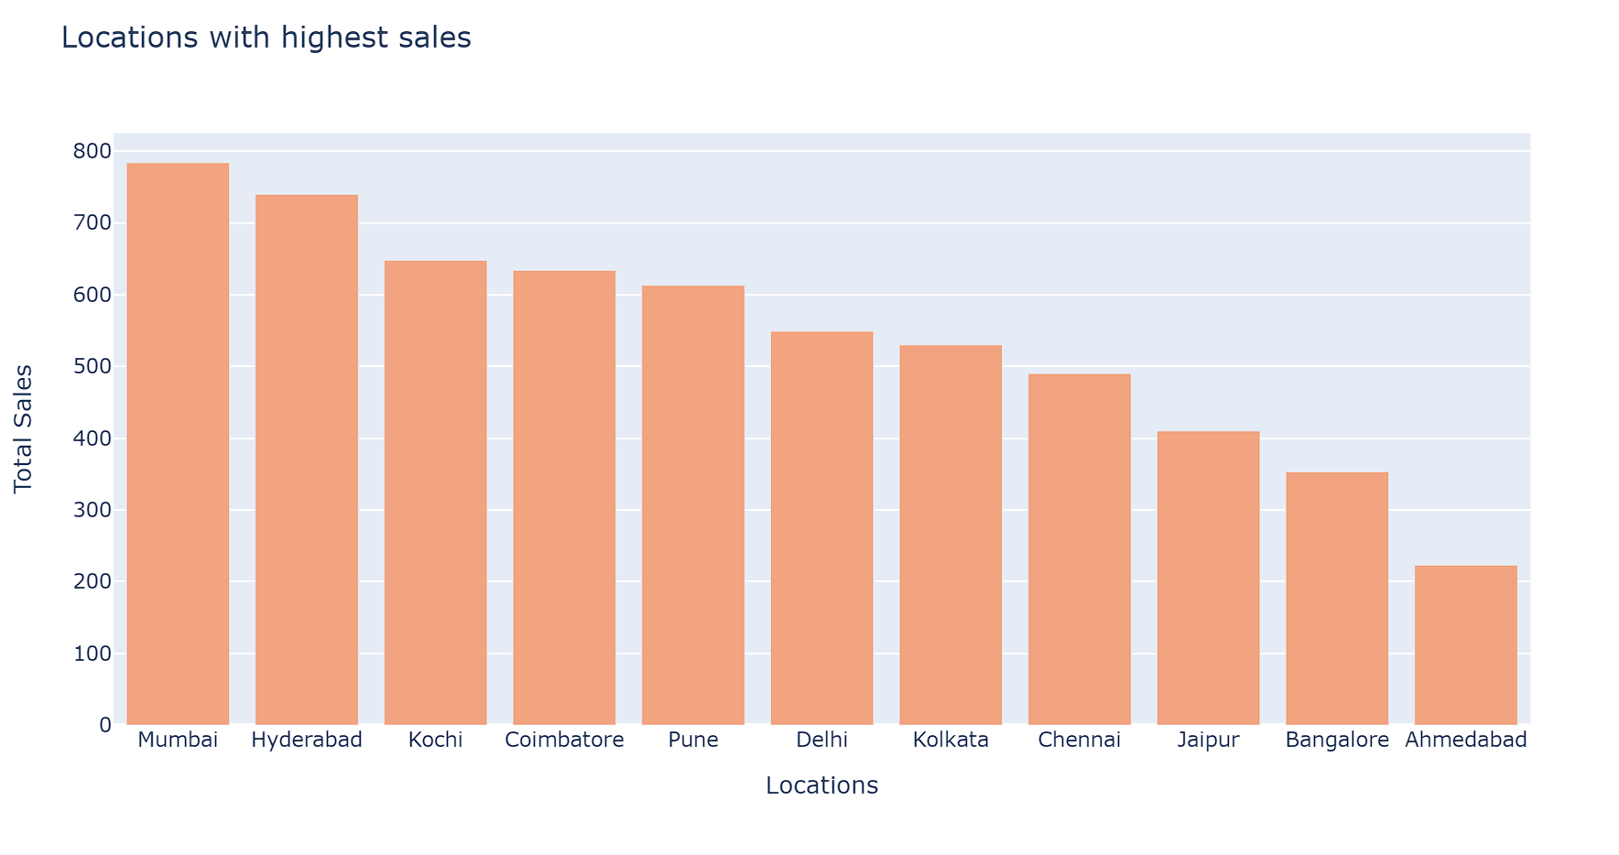
Univariate ANALYSIS
The graph helps identify locations that are performing well in terms of sales.
Locations with taller bars indicate higher sales activity and may be considered strong markets.

Slide 21
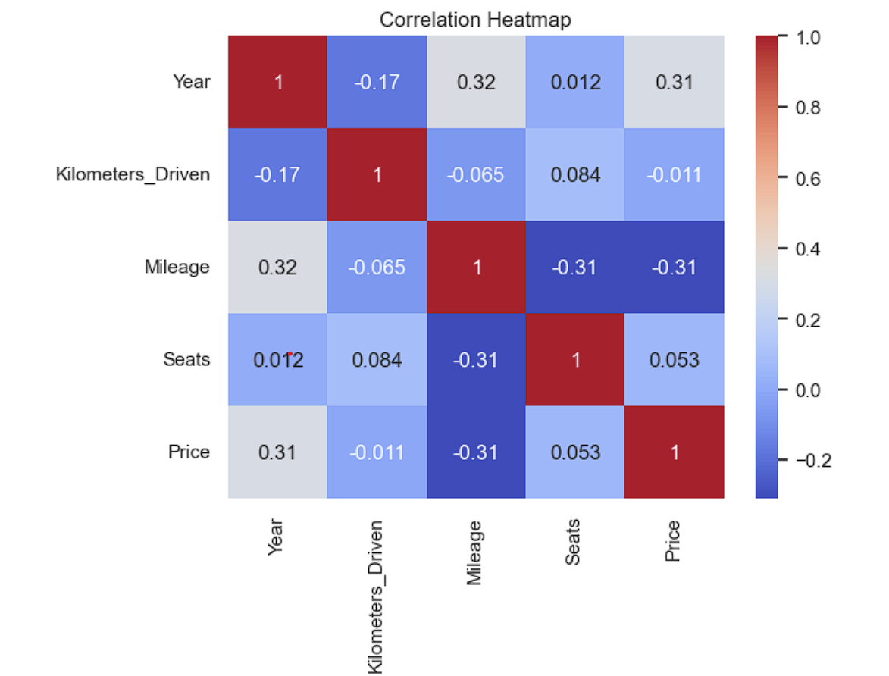
Bivariate Analysis
A heatmap (or heat map) is a is a graphical representation of a correlation matrix
where each cell in the heatmap represents the correlation coefficient between two variables.

Slide 22
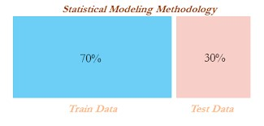
Train/Test Split
The model is trained on the training set and evaluated on the testing set.
The training set is used to train the model on known data, while the testing set is used to evaluate the model's performance on unseen data.
The performance metrics are calculated based on the model's predictions on the testing set.

Slide 23
Modelling
The Modelling process involves Model selection, model prediction, and Model Evaluation of the Dataset.
Types of Regressor model used in dataset:
Linear Regression
Polynomial Regression
Lasso Regression
Ridge Regression

Slide 24
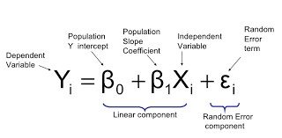
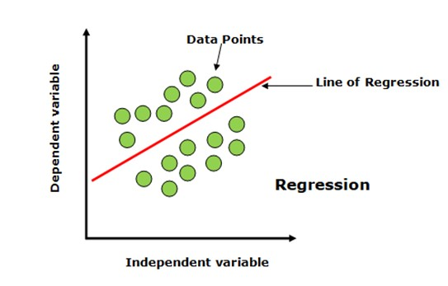
Linear regression
Linear regression is a statistical modeling technique used to establish a linear relationship between a dependent variable (target variable) and one or more independent variables
The goal of linear regression is to estimate the coefficients (β0, β1, β2, ...) that minimize the sum of squared residuals

Slide 25
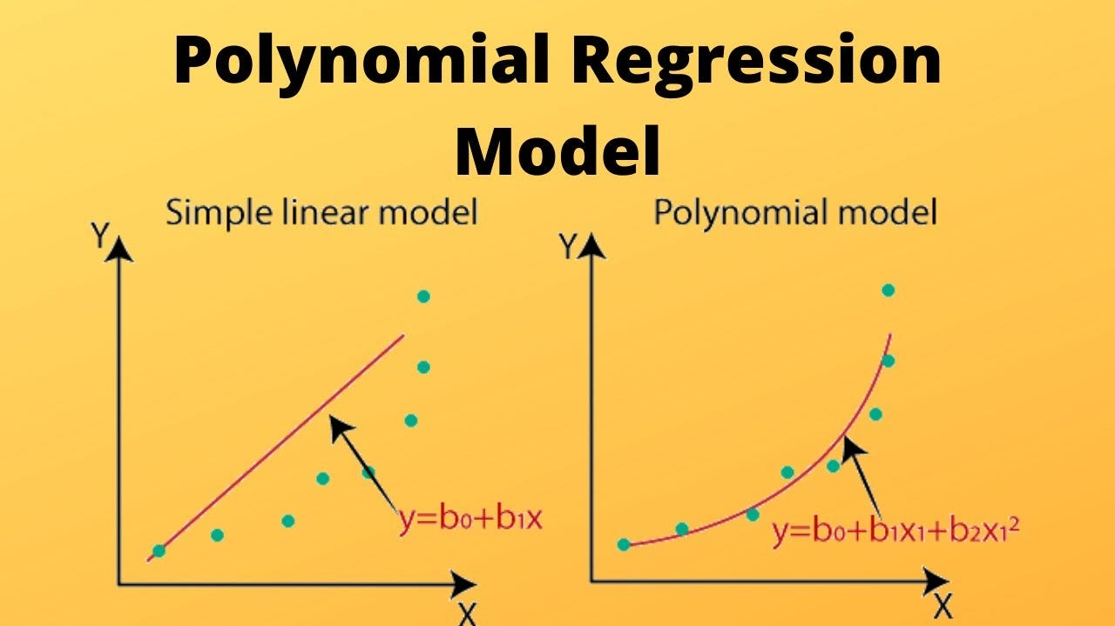
Polynomial regression
Extends the linear regression model by adding polynomial terms of the independent variables, resulting in a curve instead of a straight line.
the relationship between the dependent variable and the independent variable(s) is represented by a polynomial equation of a specified degree

Slide 26
Regularization
Regularization is a technique used to prevent overfitting and improve the generalization performance of models.
It involves adding a penalty term to the loss function during model training,
which helps to control the complexity of the model and reduce the impact of irrelevant features

Slide 27
Types of Regularization
1.Lasso Regularization
2. Ridge Regression

Slide 28
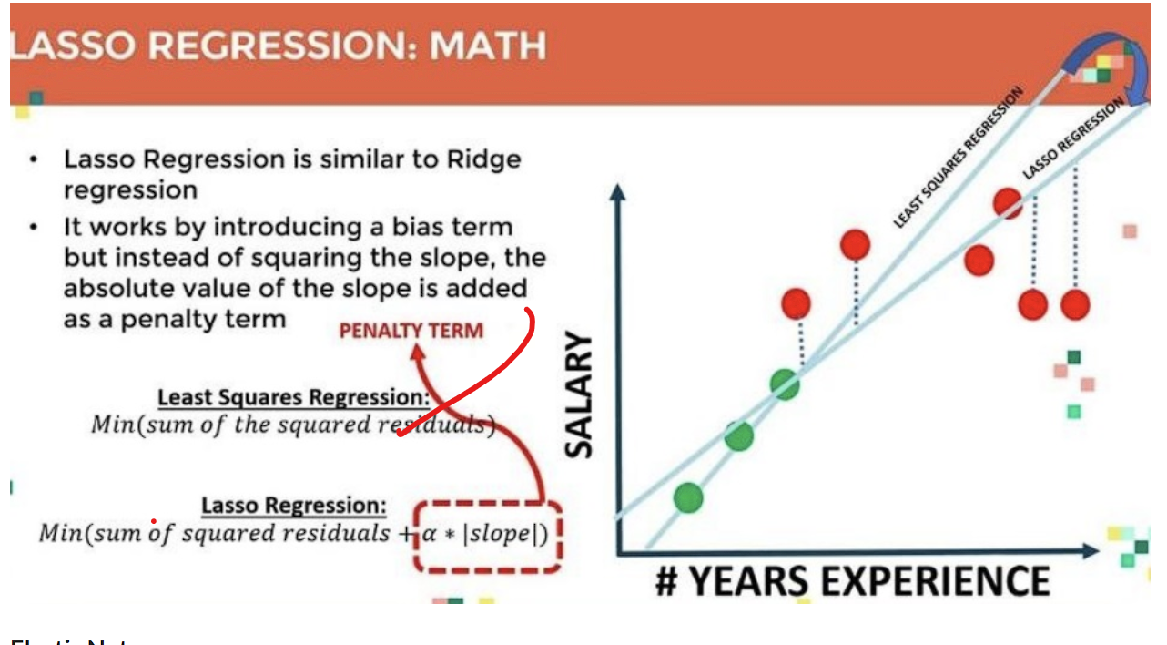
1.Lasso regression

Slide 29
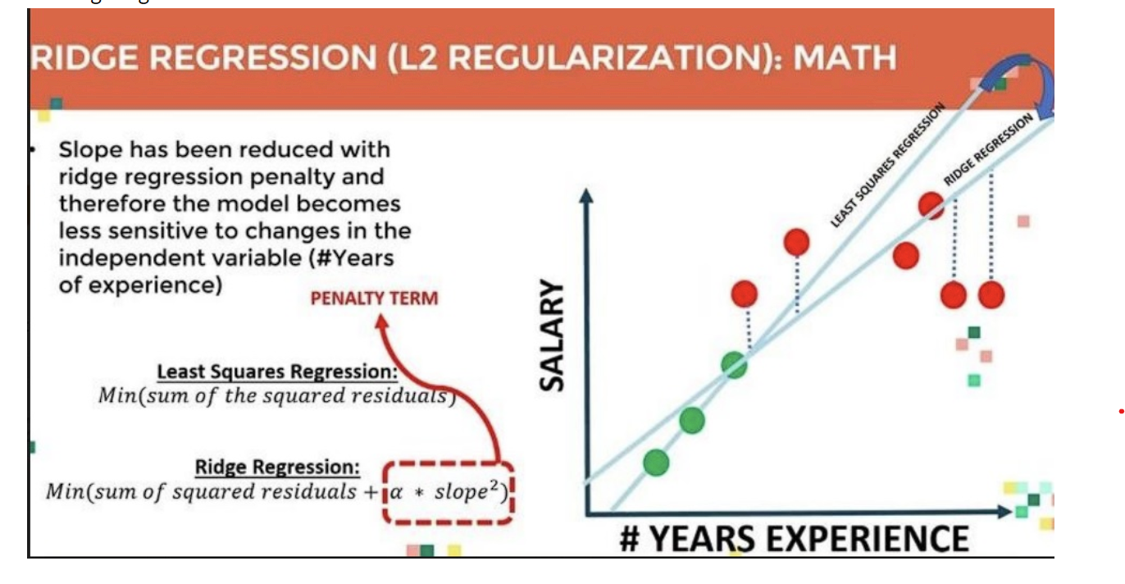
2.Ridge regression

Slide 30
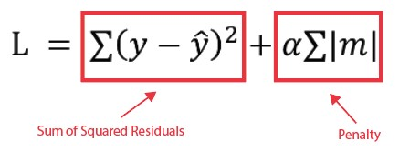
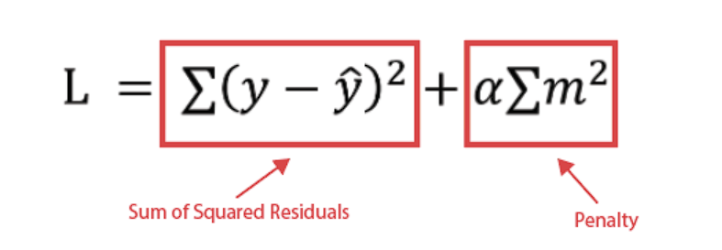
1. Lasso Regression
2.Ridge Regression

Slide 31
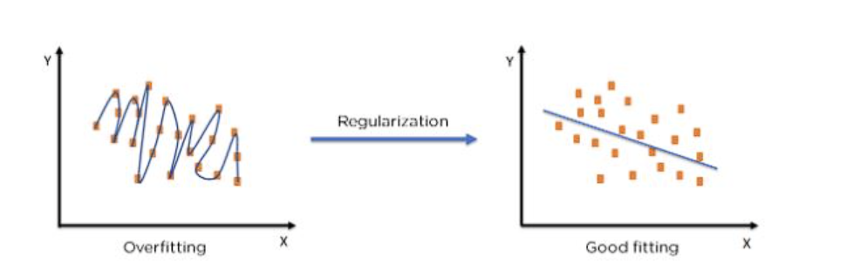

Slide 32
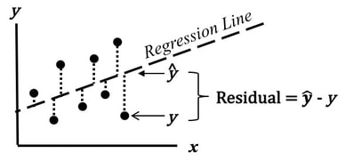
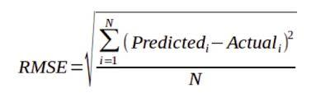
Evaluation Metrics
RMSE (Root Mean Square Error)
Measures the difference between actual value and predicted value
calculated by taking the square root of the mean of the squared differences between the predicted and actual values.

Slide 33
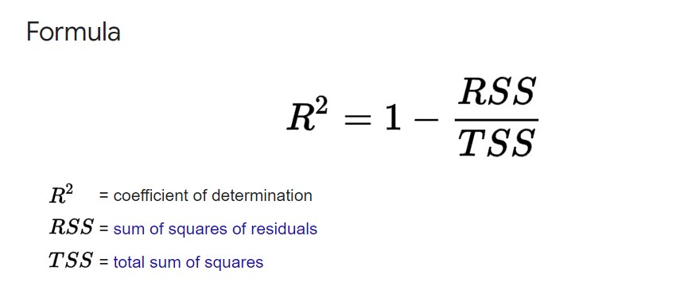
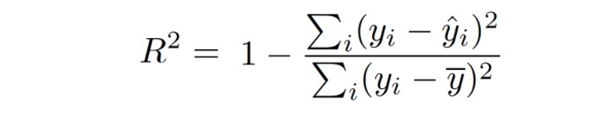
Evaluation Metrics
R squared - coefficient of determination
commonly used evaluation metric for regression problems
R-squared provides an indication of how well the regression model fits the data.
R-squared used to determine Accuracy
Ranges from 0 to 1

Slide 34
Model selection
MODEL | Train RMSE | Test RMSE | TRAIN R2 | TEST R2
LINEAR REGRESSION | 5.604427 | 6.772717 | 0.729071 | 0.680967
POLYNOMIAL REGRESION | 3.247105 | 4.995805 | 0.909054 | 0.826412
Ridge regression | 5.604511 | 6.77070 | 0.729063 | 0.826412
Lasso regression | 6.323072 | 7.437417 | 0.655135 | 0.615272

Slide 35
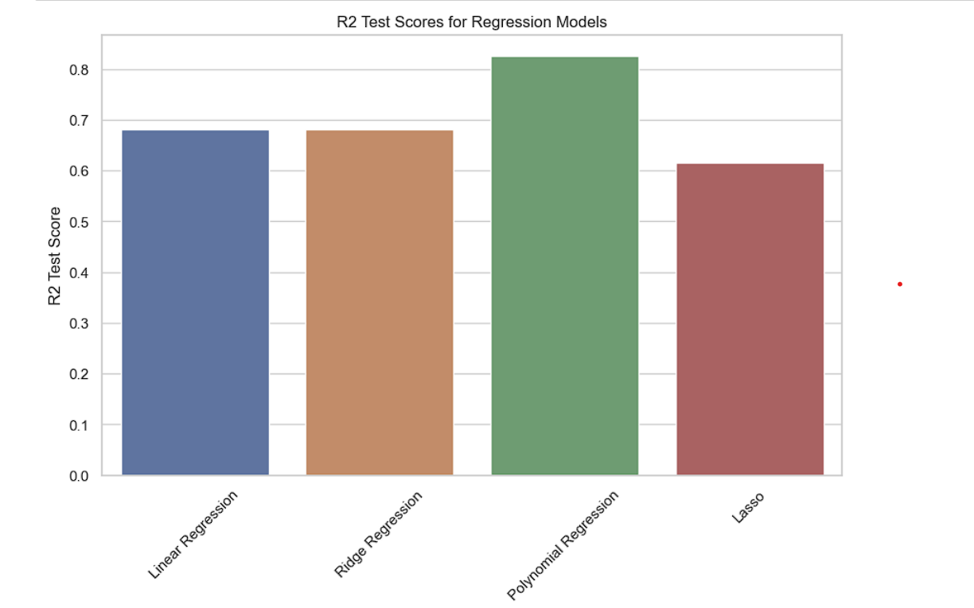
Model Performance (Accuracy):

Slide 36
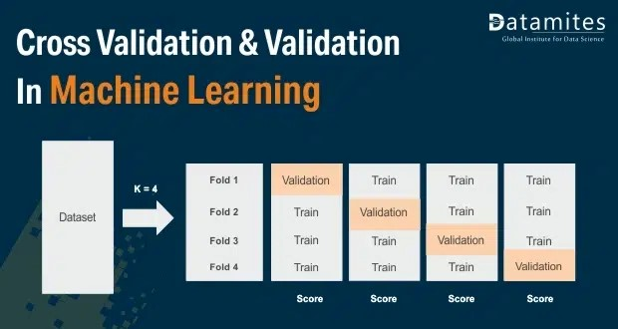
Cross Validation
The dataset is divided into multiple subsets or "folds.“
The model is trained on a combination of folds and evaluated on the remaining fold.
This process is repeated multiple times, with each fold as the testing set once.

Slide 37
Conclusion:
In this project, a Polynomial Regression Model was successfully implemented employing various prominent algorithms from the Python libraries and modules.
After the collection of data was done, further processing of data was done. The null entries and missing data points were removed from the dataset and the categorical variables were also processed using the One Hot Encoding technique.
The r2 score of Polynomial Regression was 82% which is good and predictions were quite close to the original selling prices.

